Slide 1
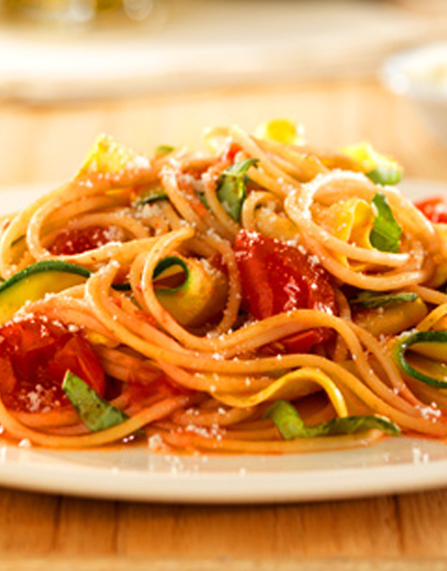


Marketing Mix Strategies to Increase Revenue in the Food Retail Sector
Product, Price, Place, & Promotion
Notes:
Changed “grocery” to “food retail” sector

Slide 2
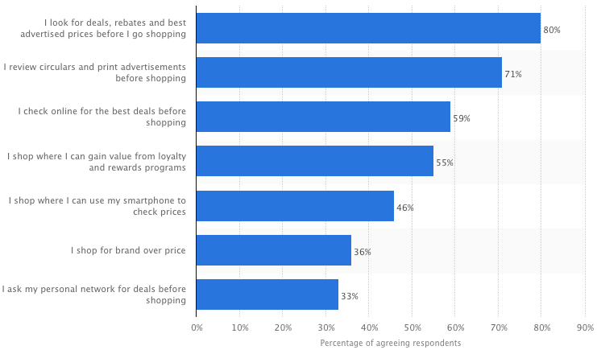
Industry Analysis: Market Fragmentation & Buyer Power
Notes:
Market Fragmentation & High Buyer Power
“Supercenters”, “Big-Box” stores, and deep discount retailers have increased competitive pressure on traditional supermarkets
KEY TAKEAWAY: CONSUMERS WANT TO COMPARISON SHOP

Slide 3
Challenges in the Food Retail Sector
High Volume, Low Margins
On average, consumers take 1.5 trips to the supermarket per week and spend 5.6% of their disposable income on groceries ($6.38B in sales)
However, profit margins hover around 1-3%
Product Assortment Challenge
In 2014, supermarkets carried an average of 42,214 SKU’s
Retailers must manage shelf space carefully and make strategic delisting decisions to facilitate easier product comparison for consumer
Removing too many high-penetration, high-frequency or strong niche brands from store shelves can drive shoppers to the competition
(Source: Food Marketing Institute, 2014)
Notes:
http://www.fmi.org/research-resources/supermarket-facts
Walmart is the largest food retailer in the US

Slide 4
Opportunities in the Food Retail Sector
New Distribution Channels: On-Demand Grocery Delivery
Services such as Instacart, FreshDirect, and Postmates have raised over $372M in funding with nearly 40% raised in 2014
Retailers can capitalize on new distribution channels by digitally promoting lower priced, higher margin products to price sensitive consumers
High Margin Substitute Products: Private-Label Perceptions
Private label sales represent 17.5% of the market for US Retailers
Globally, 59% of consumers indicated they would buy more private label if a larger variety of products were available
However, growth has been stagnant – private label share only increased by 1.3 percentage points between 2009 – 2013
(Source: Nielsen Private Label Report, 2014)
Notes:
Online ordering services provide a huge improvement to the user experience of traditional grocery shopping. It’s overwhelming to compare multiple products based on price in an aisle with other busy shoppers.
Emphasizing what we learned about private-label domination in the pasta, pancake, and syrup categories here
http://www.nielsen.com/content/dam/nielsenglobal/kr/docs/global-report/2014/Nielsen%20Global%20Private%20Label%20Report%20November%202014.pdf

Slide 5

Available Data – What Would You Do?
• 53K observations collected over 2 yrs
Store
Geography
Household
Week
Day
Time of transaction
Basket
UPCI
Coupon
Sales in dollars
Product description
Brand
Product size
Whether or not it is a commodity

Slide 6
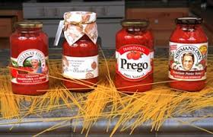
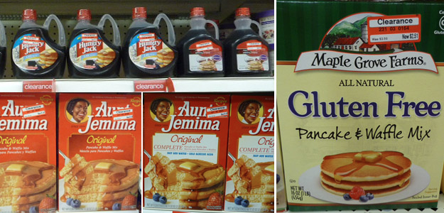
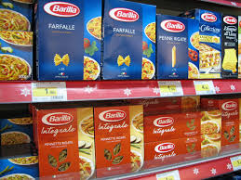
How Can Food Retailers Maximize Revenue?
Pasta and Sauce
Pancakes and Syrup
The participant with the best answer wins a prize!
Notes:
Given the available data shown in the previous slide….

Slide 7
Methodology
Product
Evaluate household penetration at the commodity and brand level
Breakfast: Pancakes & Syrup
Dinner: Pasta & Sauce
Price
Determine price elasticity and cross price elasticity between complementary goods
Log-Log Models & Instrument Variables
Promotion
Analyze the effect of coupons on brand adoption (repeat purchases)
Brand Loyalty Index
Multi-Dimensional Scaling
Placement
Optimal assortment and shelf-placement strategies are informed by price and promotion analysis

Slide 8
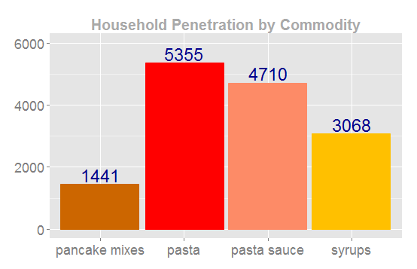
Household Penetration at the Commodity Level
Notes:
Pasta and Pasta sauce are consumed as a dinner meal while more and more families are eating breakfast on the go - explains the variation volume of sales
Pasta and Pasta Sauce are purchased in similar volumes suggesting a close to 1:1 ratio in use
Syrup and pancake mix are purchased in a 2:1 ratio

Slide 9
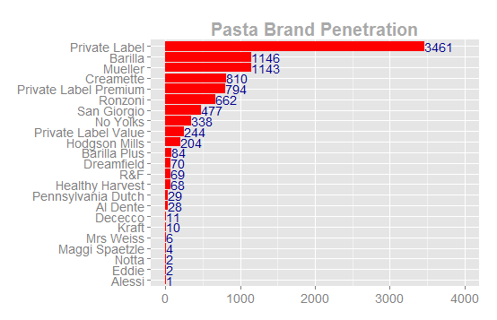
Household Penetration: Pasta Brands
Notes:
Private label heavily dominates in the pasta category, with a few key brand names followed by a heavily fragmented market

Slide 10
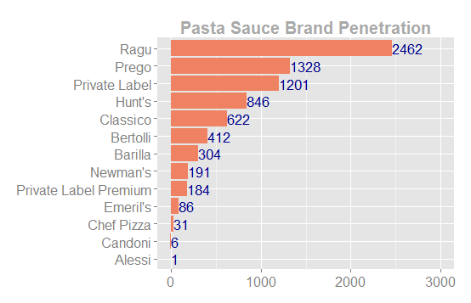
Household Penetration: Pasta Sauce Brands
Notes:
Pasta sauce appears to be less fragmented and more dominated by brand name players
It would be advantageos to pair private label pasta with a higher margin pasta sauce - PLACEMENT

Slide 11
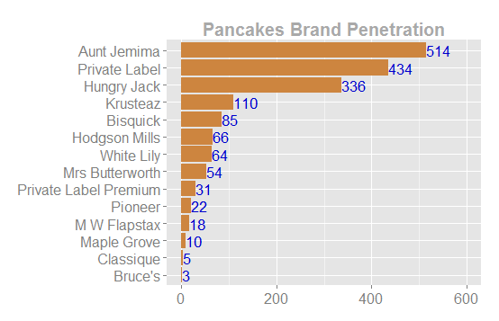
Household Penetration: Pancake Brands
Notes:
Aunt Jemima and private label occupy the majority of this space. Surprisingly, private label dominates in the syrup market. However, because syrup is purchased more frequently, customers are likely more price sensitive to the purchase. Whereas, with pancake mix, it is a rare, and special, purchase, so a brand name is more important. Similarly, we want to pair a high margin pancake mix with a private label syrup.

Slide 12
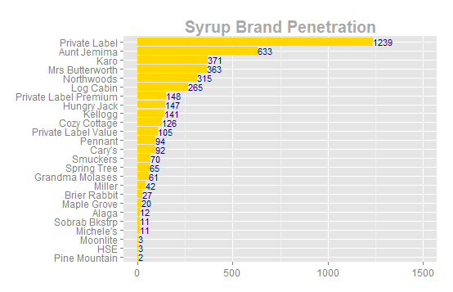
Household Penetration: Syrup Brands

Slide 13
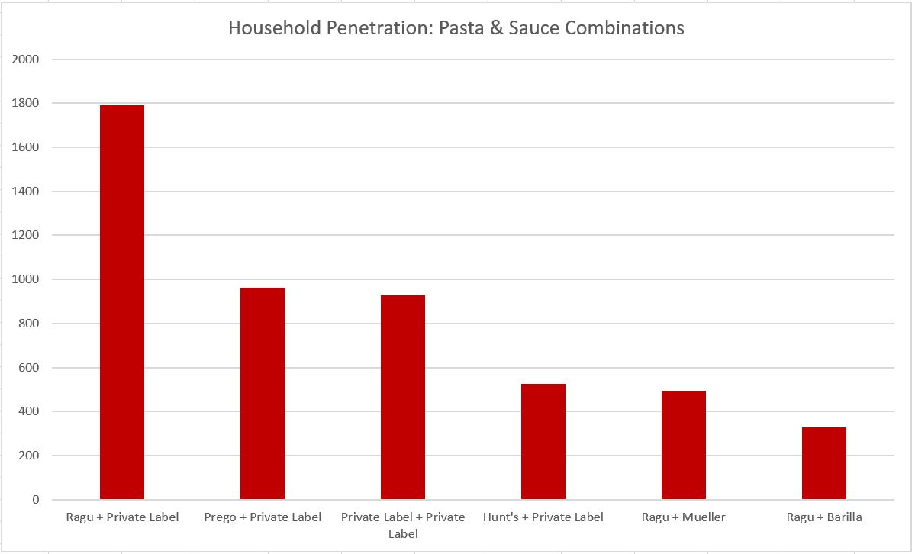
Complementary Goods: Pasta and Pasta Sauce
Notes:
Private label sells well with brand name products.. To boost sales, these two products should be placed close together in the same isle and potentially promoted with a bundled coupon.
Private label pasta is commonly purchased as a complement
Brand name sauce is most commonly purchased
Consumers are more interested in the pasta sauce brand than brand of pasta

Slide 14
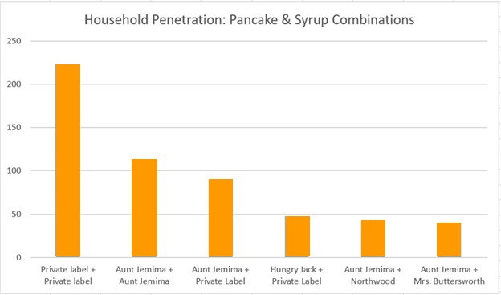
Complementary Goods: Pancakes and Syrup
Notes:
Here the customers are more likely to purchase both private label syrup and pancake mix. This is good for the grocer, such that they should encourage the purchase of both private label syrup and pancake mix to boost the bottom line. These two products should be placed close together and promoted well. Placing the private label near the more expensive brand names will also encourage higher sales for price sensitive consumers.
Private label and Aunt Jemima are often purchased with their branded counterpart or each other
Little brand name loyalty in this category
Store managers should position private label complements together

Slide 15
Insights from Observing Demand
Customers want to comparison shop!
Growing private label buy-in and dominance
Positioning and Product Placement
In store placement
Aisle caps
Place private label near a private label complement when both control segment
Place private label near a high margin brand name complement to boost revenue and store brand product sales
Digital channels
Easy to compare store brand and brand name products

Slide 16
What is a Brand Loyalty Index?
What was the logic behind our brand loyalty index?

Slide 17
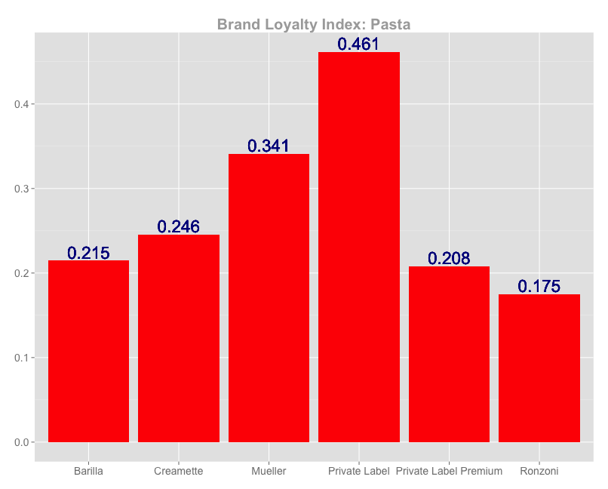
Brand Loyalty Index: Pasta
Notes:
Highest loyalty awarded to the private label in the pasta industry as expected when compared to volume of sales. However, because there is less loyalty in this market, the grocer has the opportunity to sway their customers to higher margin products through potential promotions.
Brand names do better with respect to loyalty in the sauce category demonstrating a consumer desire for well branded sauces. This can be attributed to better perceived taste, nostalgia, health, ingredients etc. This can be used to partner high margin sauce with the private label pasta.

Slide 18
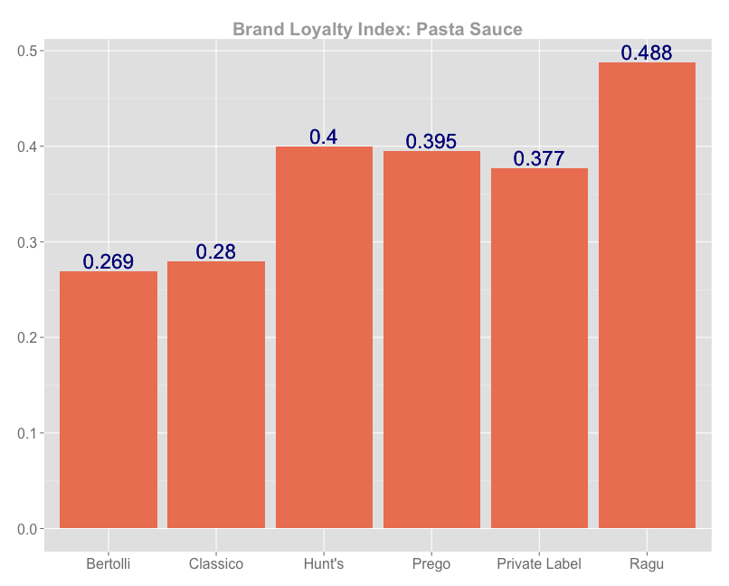
Brand Loyalty Index: Pasta Sauce

Slide 19
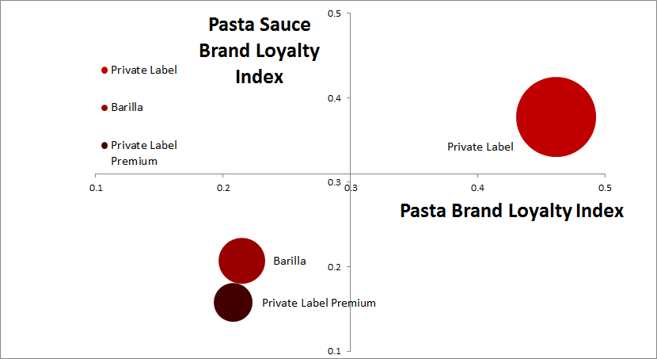
MDS: Pasta and Pasta Sauce
Notes:
When looking at brands that offer both pasta and pasta sauce, private label holds the strongest brand loyalty. This can be attributed to high price sensitivity, and the fact that few brands offer both pasta and sauce. This demonstrates that most brands in this space focus on one side of the market. Given this perceptual map, the grocer ought to place the private label pasta and sauce where it is easily seen so that they can be sold together, or with complementary higher margin products dependent on the manager's goals. Private label pasta already sells well, and the loyalty behind the product can be leveraged to encourage the purchase of either the private label brand sauce or a high margin sauce such as Ragu, since private label products are not likely to detract from the sales of a big brand name such as Ragu.

Slide 20
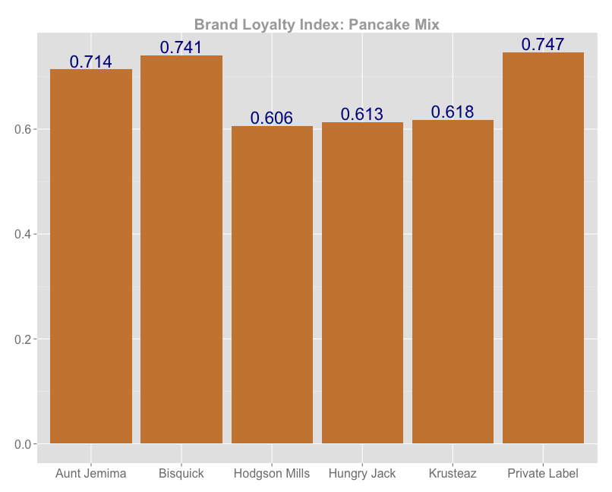
Brand Loyalty Index: Pancake Mix
Notes:
This market mix has higher brand loyalty that that of pasta and sauce. This category also conducts what appears to be less frequent sales. It is likely that these products are purchased for “special” occasions, such as family breakfast (which occur less frequently), and as such more thought goes into the brand of the commodity. However, there is still a large percentage of loyalty awarded to the private label suggesting that there is a large segment of price sensitive customers unaffected or uninterested in the brand name. Because consumers are slightly more loyal, it may be possible to boost margins by increasing prices slightly. Coupons can then be used as incentives.

Slide 21
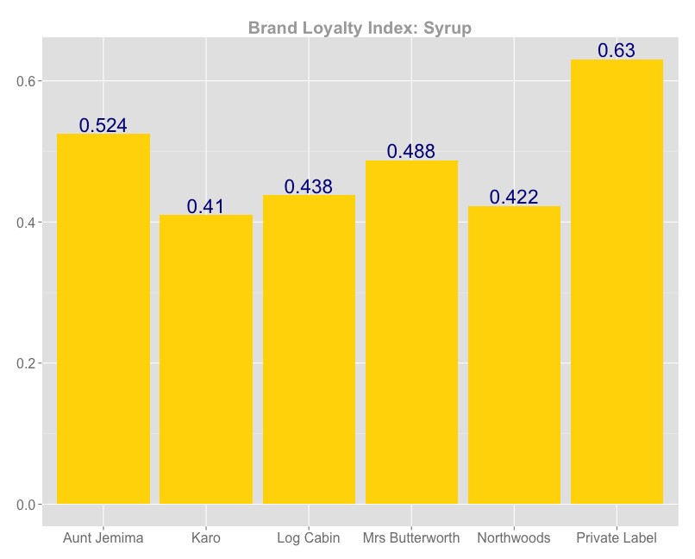
Brand Loyalty Index: Syrup

Slide 22
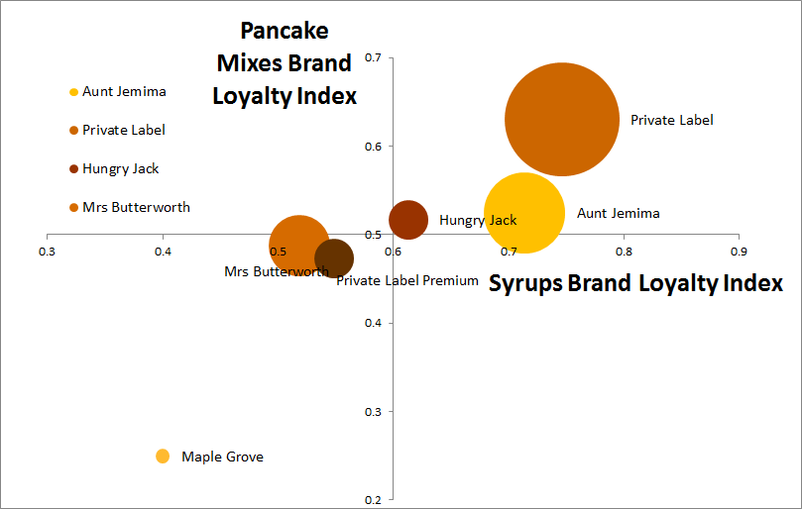
MDS: Pancakes and Syrup
Notes:
Similarly, to pasta and sauce, the private label is the largest player in this market, followed by big brand names. This demonstrates that a brand’s biggest “enemy” is the private label, but also that the grocer can leverage the loyalty to its store products to encourage the purchase of a higher margin pancake mix or syrup via coupons and promotions. Additionally, this information can be used when determining how to stock products. The products that are both high margin and purchased often should be placed at eye level, whereas those that are low margin and have little brand affinity should be places on lower and hard to reach shelves. Further, the grocer ought to determine if the low selling and low brand awareness products are helpful with capturing niche markets, or if another product would be better suited to the shelf space to maximize profits.

Slide 23
Insights from Observing Brand Loyalty
Customers tend to more brand loyal in segments where purchasing is less frequent

Slide 24
Effect of Coupons on Brand Adoption
LOGIC BEHIND THIS ANALYSIS?

Slide 25
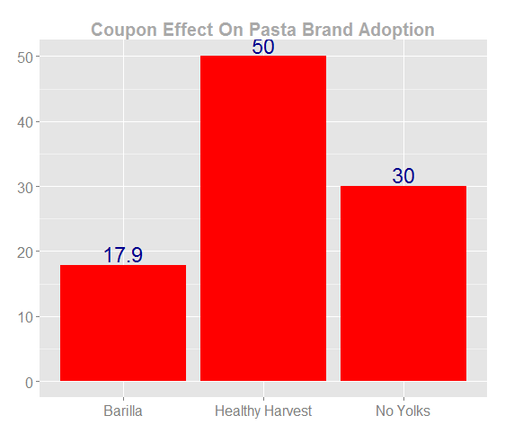
Coupon Effect on Pasta Brand Adoption
Notes:
Demonstrates the number of people who purchase an item using a coupon to purchase this brand for the first time and then repeat the purchase.
We should use coupons on the private label sauce, as seen by the number of repeat purchases. This demonstrates that couponing is effective for private label, which is good for the grocer as they want an increase in private label sales. Alternatively looking at pasta sales, private label already sales well. As such, coupons are not effective in this market and should not be used on the private label pasta. However, couponing is effective for small brand pasta brands.
Note- actual discount unknown

Slide 26
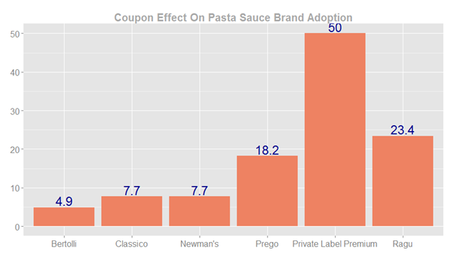
Coupon Effect on Pasta Sauce Brand Adoption

Slide 27
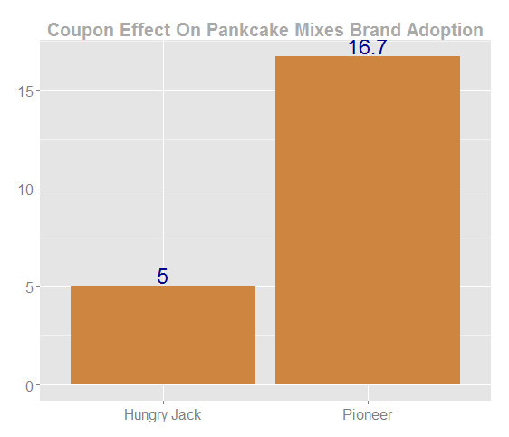
Coupon Effect on Pancake Mix Brand Adoption
Notes:
Demonstrates the number of people who purchase an item using a coupon to purchase this brand for the first time and then repeat the purchase.
If pioneer, northwood and spring tree are all higher margin products than the current best seller, consider offering coupons for these products, as the coupon clearly generate repeat purchase behavior for these brands. Otherwise, avoid coupons for these products as they will diminish margins.
Note- actual discount unknown

Slide 28
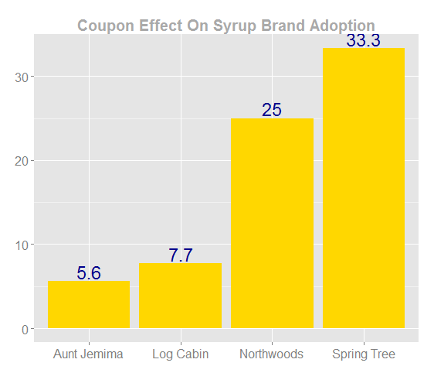
Coupon Effect on Syrup Brand Adoption

Slide 29
Insights from Observing Coupon Effect on Brand Adoption
What can we conclude/recommend based on this analysis?

Slide 30
Introduction to Price Elasticity Models
Let’s introduce the logic before we present our insignificant results

Slide 31
Price Elasticity Modeling Results
Pasta Sales
Pasta Price | -.45
Pasta Sauce Price | -.13
Lag Pasta Sales | .06
Pasta Coupon | .01
Pasta Sauce Sales
Pasta Sauce Price | .52
Pasta Price | -1.62
Lag Pasta Sauce Sales | .07
Pasta Sauce Coupon | .07
Pancake Mix Sales
Pancake Mix Price | .93
Syrup Price | -.32
Lag Pancake Mix Sales | .10
Pancake Mix Coupon | .09
Syrup Sales
Syrup Price | -.62
Pancake Mix Price | -.04
Lag Syrup Sales | .05
Syrup Coupon | .07
Notes:
Model 1:
Pasta sales are elastic wrt pasta price, but pasta sales are not related to pasta sauce price thus, we cannot calculate the cross price elasticity. The lagged pasta sales have some effect on future pasta sales, which is expected.
Model 2:
There’s cross price elasticity effect in this model: pasta sauce sales are elastic w.r.t. pasta price. We also see lag pasta sauce sales have some effect on future sales. Also weekly coupons have some effect on pasta sauce sales
Model 3:
The price elasticity for Pancakes mixes is positive w.r.t pancakes mixes price but negative w.r.t syrup prices.
Model 4:
The price elasticity for syrup is positive w.r.t syrup prices. Also, weekly coupons and lag syrup sales have positive effect on syrup sales. Coupon contribution can be contributed to high number of coupons for Syrups
*Every attribute is on a log scale
Generally increase in product or compliment price has a negative effect on sales
Statistically significant effect of coupons on sales for Pasta Sauce and Syrups

Slide 32
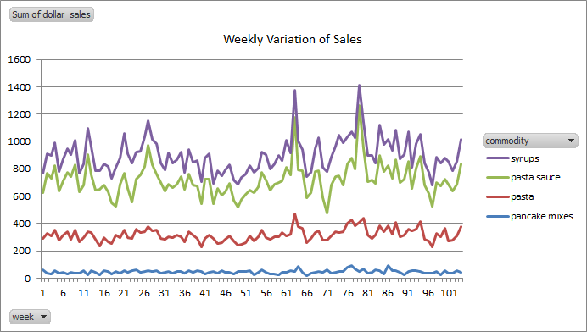
Exploring Statistical Insignificance
Notes:
Unknown external factors not covered in the data - weather, ingredient price etc.
There are major peaks for sales at week 23, 62,72. We don’t see corresponding change in price. Hence, our price elasticity models are not performing well. Maybe there is seasonal effect or price change in ingredients of underlying commodity.

Slide 33
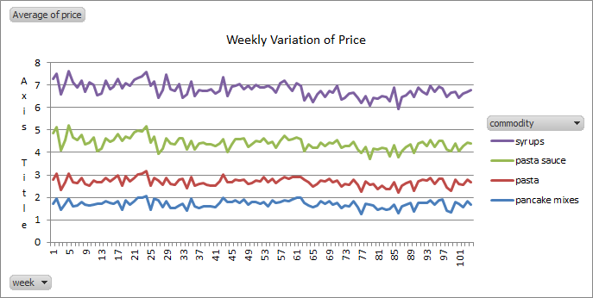
Exploring Statistical Insignificance

Slide 34
The Search for Instrument Variables
Used to predict causal relationships when a treatment is not successfully delivered to every unit in a randomized model experiment
Unexpected positive values with respect to price of pancake mix and pasta sauce
The errors are correlated to price (independent) and sales (dependent)
Instrumental variable is used to uncorrelated error with an endogenous variable
Endogenous variable needs to affect price but not sales
Idealy, the price of ingredients in the product (tomatoes in pasta sauce)
Without weekly data ingredient prices could not be tracked
Lag of sales was used. Found to be insignificant
Lag of coupon was used. Found to be insignificant
Notes:
Change in price of commodity alone is not able to explain change in sales. Errors are also correlated to both price of commodity(independent variable) and sales(dependent variable). In our case, price is the endogenous variable. Using instrument analysis we can find a variable that un correlates error with endogeneous variable. The ideal variable would be price of items used to make the commodity(for instance Tomato Prices) that directly affect price of commodity but not sales. However we don’t have the exact dates in our data set to be able use weekly tomato prices in our model. Hence, we used lag of commodity sales as an instrument variable. The coefficients were not significant after I used lag sales as instrument variable

Slide 35
Final Recommendations
Product
Private vs. branded
Price
Optimize high margin priced products to generate high revenue
Ensure that the private label is priced to maximize quantity sold and profits
Promotion
Run alternating and bundled coupon campaigns
Encourage in store taste tests to boost first time product use of high margin products
Placement and Stocking
Position complementary goods with high margins close to private label goods
Optimize shelf space, and back stock based on brands that preform the best
Notes:
Position complementary goods with high margins close to private label to encourage purchase
i.e. high margin Ragu pasta sauce near well selling private label pasta to boost sales of both
Optimize shelf space based on brands that perform the best
i.e Aunt Jemima at eye level, Maple Grove on the lowest shelf
Run bundled coupon campaigns
High sales volume and loyalty to private label syrup can be leveraged to increase sales for high margin pancake mixes using a “buy this get that” coupon
Encourage in store taste tests to boost first time product use of high margin products
Additionally, offer a coupon to generate first time, and ideally repeat sales

Slide 36

Questions?

Slide 37
Summary of Findings

Slide 38
Pasta and Pasta Sauce
Frequently purchased, but there is little brand name loyalty in the category aside from a few key players
Overall fragmented market
Once in consideration set, purchased without much thought
Provides room for coupon use to boost sales of high margin or new products
Private label pasta makes up the majority of sales with 64% market share
i.e. consumers are not brand sensitive, but price sensitive, in the pasta market
Often purchased with name brand sauce
Ragu and Prego combined hold 80% of the market for pasta sauces
i.e. consumers are more concerned with brand name in the pasta sauce market
Feelings of nostalgia
Consumers believe “pasta sauce makes the pasta”

Slide 39
Pancakes and Syrup
Less frequent purchases but higher brand loyalty
More brand affiliation in the pancake mix category than syrup
Possibly for special occasions such as weekend family breakfast
Aunt Jemima holds 35% of the pancake mix market followed by the private label with 30%
Consumers are more attached to a brand name pancake mix
The private label is the leader in the syrup market with 40% market share followed by Aunt Jemima with 20%
Consumers are less concerned with brand name syrup
Pancake mix and syrup of either the private label of Aunt Jemima are commonly purchased with a compliment of the same brand or together

Slide 40
Overall
Customers are price sensitive in the commodity space, as such effective pricing drives sales
Highest “brand loyalty” to private label
Sales are negatively impacted by an increase in price
Commodity products operate in highly fragmented spaces
Placement on shelves is key in driving sales of high margin products
Coupons can increase brand usage, especially for smaller brands
Hopes of turning one time opportunity shoppers into brand loyal repeat buyers
Can be leveraged to promote sales of high margin or private label products based on sales goals

Slide 41
Recommendations

Slide 42
To the Manager…
Pricing
Ensure that the private label is priced to maximize quantity sold and profits
Placement and Stocking
Position complementary goods with high margins close to private label to encourage purchase
i.e. high margin Ragu pasta sauce near well selling private label pasta to boost sales of both
Optimize shelf space based on brands that perform the best
i.e Aunt Jemima at eye level, Maple Grove on the lowest shelf
Determine optimal volume of back stock to reduce shortages of top selling brands with high margins

Slide 43
To the Manager Continued…
Promotions
Run alternating coupon campaigns
Run bundled coupon campaigns
High sales volume and loyalty to private label syrup can be leveraged to increase sales for high margin pancake mixes using a “buy this get that” coupon
Encourage in store taste tests to boost first time product use of high margin products
Additionally, offer a coupon to generate first time, and ideally repeat sales

Slide 44
Appendix

Slide 45
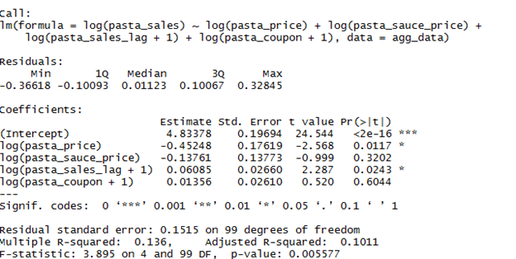
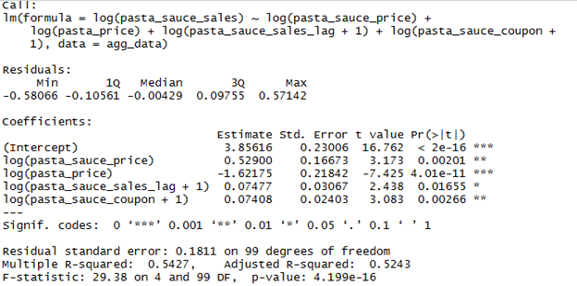

Slide 46
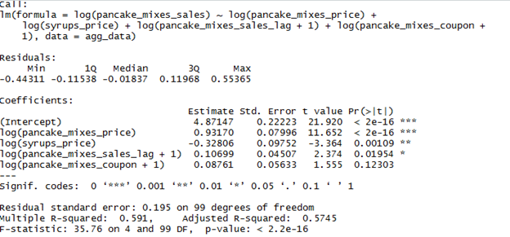
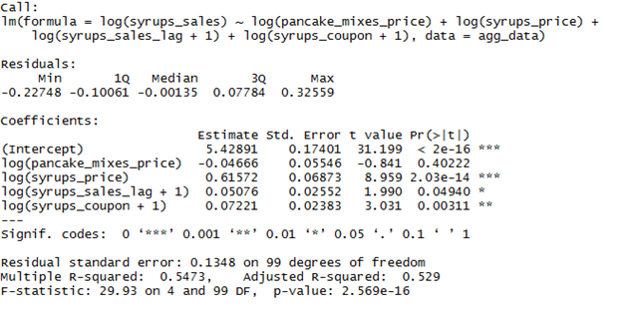

Slide 47
